Slide 1
Discriminant Functions
Generative Models
Discriminative Models
Linear Models for Classification

Slide 2

Classification: Hand-written Digit Recognition
Discriminant Functions Generative Models Discriminative Models
x_{i} = t_{i} = (0, 0, 0, 1, 0, 0, 0, 0, 0, 0)
Each input vector classified into one of K discrete classes
Denote classes by C_{k}
Represent input image as a vector x_{i} ∈ R⁷⁸⁴.
We have target vector t_{i} ∈ {0, 1}¹⁰
Given a training set {(x₁, t₁), . . . , (x_{N}, t_{N} )}, learning problem is to construct a “good” function y(x) from these.
y : R⁷⁸⁴ → R¹⁰

Slide 3
Discriminant Functions
Generative Models
Discriminative Models
Generalized Linear Models
we will use a “linear” model for classification:
y(x) = f (w^{T} x + w₀)
This is called a generalized linear model
f (·) is a fixed non-linear function
e.g.
1 if u ≥ 0
f (u) =
0 otherwise
Decision boundary between classes will be linear function of x
Can also apply non-linearity to x, as in φ_{i}(x) for regression
Alireza Ghane / Greg Mori

Slide 4
Discriminant Functions
Generative Models
Discriminative Models
Generalized Linear Models
Similar to previous chapter on linear models for regression, we will use a “linear” model for classification:
y(x) = f (w^{T} x + w₀)
This is called a generalized linear model
f (·) is a fixed non-linear function
e.g.
1 if u ≥ 0
f (u) =
0 otherwise
Decision boundary between classes will be linear function of x
Can also apply non-linearity to x, as in φ_{i}(x) for regression
Linear Models for Classification
Alireza Ghane / Greg Mori
3

Slide 5
Discriminant Functions
Generative Models
Discriminative Models
Generalized Linear Models
Similar to linear models for regression, we will use a “linear” model for classification:
y(x) = f (w^{T} x + w₀)
This is called a generalized linear model
f (·) is a fixed non-linear function
e.g.
1 if u ≥ 0
f (u) =
0 otherwise
Decision boundary between classes will be linear function of x
Can also apply non-linearity to x, as in φ_{i}(x) for regression
Alireza Ghane / Greg Mori

Slide 6
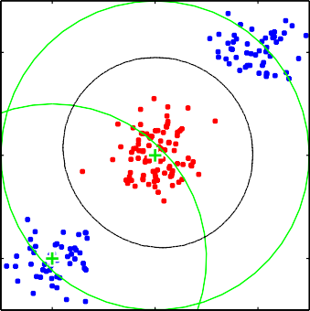

Discriminant Functions
Generative Models
Discriminative Models
Generalized Linear Model
1
1
0
0.5
−1
0
−1
0
1
0
0.5
1
y(x) = f (w^{T} φ(x) + w₀)
x
1
φ (x , x )
y
= f w
w
1 1 2
+ w
x₂
1
2
φ₂(x₁, x₂)
0
Alireza Ghane / Greg Mori

Slide 7
Discriminant Functions
Generative Models
Discriminative Models
Outline
Discriminant Functions
Generative Models
Discriminative Models
Alireza Ghane / Greg Mori

Slide 8
Discriminant Functions
Generative Models
Discriminative Models
Discriminant Functions with Two Classes
y > 0
y = 0
y < 0
x₂
Start with 2 class problem,
R₁
t ∈ {0, 1}
R₂
i
Simple linear discriminant
y(x) = w^{T} x + w₀
apply threshold function to get classification
w^{T} x
W dictates the orientation and w₀ – location of decision surface
x
w
y(x)
ǁwǁ
x⊥
x₁
−w0
Projection of x in w dir. is
ǁwǁ
||w||
Alireza Ghane / Greg Mori

Slide 9
Discriminant Functions
Generative Models
Discriminative Models
Multiple Classes
A linear discriminant between two classes separates with a hyperplane
How to use this for multiple classes?
One-versus-the-rest method: build K − 1 classifiers, between C_{k} and all others
One-versus-one method: build K(K − 1)/2 classifiers, between all pairs
Alireza Ghane / Greg Mori

Slide 10
Discriminant Functions
Generative Models
Discriminative Models
Multiple Classes
A linear discriminant between two classes separates with a hyperplane
How to use this for multiple classes?
One-versus-the-rest method: build K − 1 classifiers, between C_{k} and all others
One-versus-one method: build K(K − 1)/2 classifiers, between all pairs
Linear Models for Classification
Alireza Ghane / Greg Mori
9

Slide 11
Discriminant Functions
Generative Models
Discriminative Models
Multiple Classes
?
^{R}1
^{R}2
^{C}1
^{R}3
C
^{not C}1
^{not C}2
2
A linear discriminant between two classes separates with a hyperplane
How to use this for multiple classes?
One-versus-the-rest method: build K − 1 classifiers, between C_{k} and all others
One-versus-one method: build K(K − 1)/2 classifiers, between all pairs
Linear Models for Classification
Alireza Ghane / Greg Mori
10

Slide 12
Discriminant Functions
Generative Models
Discriminative Models
Multiple Classes
_{C} ^{C}3
1
?
^{R}1
^{R}1
C
^{R}3
^{R}2
1
?
C
^{C}3
1
^{R}3
^{R}2
C
2
^{C}2
^{not C}1
C
^{not C}2
2
A linear discriminant between two classes separates with a hyperplane
How to use this for multiple classes?
One-versus-the-rest method: build K − 1 classifiers, between C_{k} and all others
One-versus-one method: build K(K − 1)/2 classifiers, between all pairs

Slide 13
Discriminant Functions
Generative Models
Discriminative Models
Multiple Classes
R_{j}
R_{i}
R_{k}
xˆ
x_{B}
x_{A}
A solution is to build K linear functions:
y_{k}(x) = w^{T} x + w_{k0}
k
assign x to class arg max_{k} y_{k}(x)
Gives connected, convex decision regions
xˆ
y_{k}(xˆ)
⇒ y_{k}(xˆ)
= λx_{A} + (1 − λ)x_{B}
= λy_{k}(x_{A}) + (1 − λ)y_{k}(x_{B} )
> y_{j} (xˆ), ∀j /= k

Slide 14
Discriminant Functions
Generative Models
Discriminative Models
Least Squares for Classification
How do we learn the decision boundaries (w_{k}, w_{k0})?
One approach is to use least squares, similar to regression
Find W to minimize squared error over all examples and all components of the label vector:
N K
1
2
Σ Σ
E(W ) =
(y (x ) − t
₎2
k n nk
n=1 k=1
Some algebra, we get a solution using the pseudo-inverse as in regression

Slide 15
Discriminant Functions
Generative Models
Discriminative Models
Least Squares for Classification
How do we learn the decision boundaries (w_{k}, w_{k0})?
3 methods: least squares, Fisher’s linear discriminant, and the perceptron algorithm
First approach is to use least squares, similar to regression
Find W to minimize squared error over all examples and all components of the label vector:
N K
1
2
Σ Σ
E(W ) =
(y (x ) − t
₎2
k n nk
n=1 k=1
Some algebra, we get a solution using the pseudo-inverse as in regression
Linear Models for Classification
Alireza Ghane / Greg Mori
15

Slide 16
Discriminant Functions
Generative Models
Discriminative Models
Least Squares for Classification
How do we learn the decision boundaries (w_{k}, w_{k0})?
One approach is to use least squares, similar to regression
Find W to minimize squared error over all examples and all components of the label vector:
1
2
N K
E(W ) =
Σ Σ
(y (x ) − t
₎2
k n nk
n=1 k=1
Some algebra, we get a solution using the pseudo-inverse as in regression

Slide 17
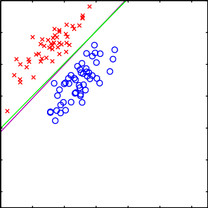
Discriminant Functions
Generative Models
Discriminative Models
Problems with Least Squares
4
2
0
−2
−4
−6
−8
−4
−2
0
2
4
6
8
• Looks okay... least squares decision
boundary
Similar to logistic regression
•
decision boundary (more later)

Slide 18
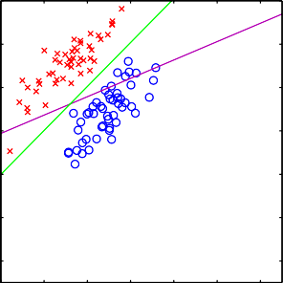

Discriminant Functions
Generative Models
Discriminative Models
Problems with Least Squares
4
4
2
2
0
0
−2
−2
−4
−4
−6
−6
−8
−8
−4
−2
0
2
4
6
8
−4
−2
0
2
4
6
8
• The left plot shows data from two classes, denoted by red crosses and blue circles, together with the decision boundary found by least squares (magenta curve) and also by the logistic regression model (green curve), which is discussed later in Section 4.3.2. The right-hand plot shows the corresponding results obtained when extra data points are added at the bottom left of the diagram, showing that least squares is highly sensitive to outliers, unlike logistic regression.
•

Slide 19
Discriminant Functions
Generative Models
Discriminative Models
Problems with Least Squares
4
4
2
2
0
0
−2
−2
−4
−4
−6
−6
−8
−8
−4
−2
0
2
4
6
8
−4 −2 0 2 4 6 8
Gets worse by adding easy points?!
Why?
Looks okay... least squares decision
boundary
Similar to logistic regression
decision boundary (more later)

Slide 20
Discriminant Functions
Generative Models
Discriminative Models
Problems with Least Squares
4
4
2
2
0
0
−2
−2
−4
−4
−6
−6
−8
−8
−4
−2
0
2
4
6
8
−4 −2 0 2 4 6 8
Gets worse by adding easy points?!
Why?
Looks okay... least squares decision
boundary
If target value is 1, points far from
Similar to logistic regression
boundary will have high error value, say 10; this is a large error so the boundary is moved
decision boundary (more later)

Slide 21
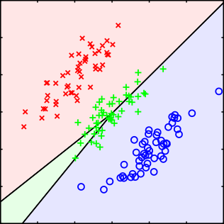
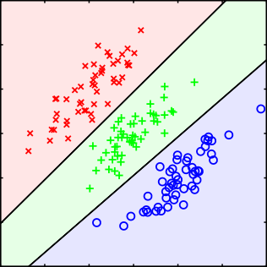
Discriminant Functions
Generative Models
Discriminative Models
More Least Squares Problems
6
6
4
4
2
2
0
0
−2
−2
−4
−4
−6
−6
−4
−2
0
2
4
6
−6
−6
−4
−2
0
2
4
6
Example of a synthetic data set comprising three classes, with training data points denoted in red (×), green (+), and blue (◦). Lines denote the decision boundaries, and the background colours denote the respective classes of the decision regions. On the left is the result of using a least-squares discriminant. We see that the region of input space assigned to the green class is too small and so most of the points from this class are misclassified. On the right is the result of using logistic regressions as described in Section 4.3.2 showing correct classification.
Easily separated by hyperplanes, but not found using least squares!, We’ll address these problems later with better models, First, a look at a different criterion for linear discriminant

Slide 22
Discriminant Functions
Generative Models
Discriminative Models
Fisher’s Linear Discriminant
The two-class linear discriminant acts as a projection:
y = w^{T} x≥ −w₀
followed by a threshold

Slide 23
Discriminant Functions
Generative Models
Discriminative Models
Fisher’s Linear Discriminant
The two-class linear discriminant acts as a projection:
y = w^{T} x≥ −w₀
followed by a threshold

Slide 24
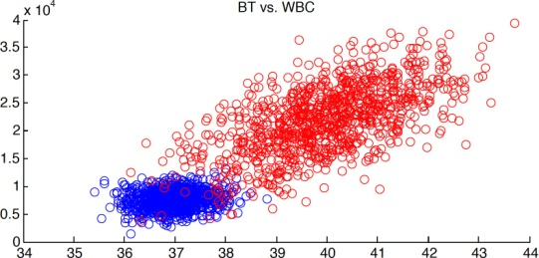
Discriminant Functions
Generative Models
Discriminative Models
Fisher’s Linear Discriminant
The two-class linear discriminant acts as a projection:
y = w^{T} x≥ −w₀
followed by a threshold
In which direction w should we project?

Slide 25
Discriminant Functions
Generative Models
Discriminative Models
Fisher’s Linear Discriminant
The two-class linear discriminant acts as a projection:
y = w^{T} x≥ −w₀
followed by a threshold
In which direction w should we project?
One which separates classes “well”

Slide 26
Discriminant Functions
Generative Models
Discriminative Models
Fisher’s Linear Discriminant
A natural idea would be to project in the direction of the line connecting class means

Slide 27
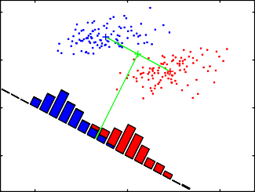
Discriminant Functions
Generative Models
Discriminative Models
Fisher’s Linear Discriminant
4
2
0
−2
−2
2
6
A natural idea would be to project in the direction of the line connecting class means

Slide 28
Discriminant Functions
Generative Models
Discriminative Models
Fisher’s Linear Discriminant
4
2
0
−2
−2
2
6
A natural idea would be to project in the direction of the line connecting class means
However, problematic if classes have variance in this direction

Slide 29
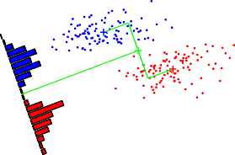
Discriminant Functions
Generative Models
Discriminative Models
Fisher’s Linear Discriminant
4
4
2
2
0
0
−2
−2
−2
2
6
−2
2
6
The left plot shows samples from two classes (depicted in red and blue) along with the histograms resulting from projection onto the line joining the class means. Note that there is considerable class overlap in the projected space. The right plot shows the corresponding projection based on the Fisher linear discriminant, showing the greatly improved class separation.
A natural idea would be to project in the direction of the line connecting class means However, problematic if classes have variance in this direction
Fisher criterion: maximize ratio of inter-class separation (between) to intra-class variance (inside)

Slide 30
Discriminant Functions
Generative Models
Discriminative Models
Math time - FLD
Projection y_{n} = w^{T} x_{n}
Inter-class separation is distance between class means (good):
1
N_{k}
Σ
m =
T
k
w x
n
n∈C_{k}
Intra-class variance (bad):
Σ
2
2
s = (y − m )
k n k
n∈C_{k}
Fisher criterion:
(m − m )
2
J(w) = ² ¹
s² + s²
1 2
maximize wrt w

Slide 31
Discriminant Functions
Generative Models
Discriminative Models
Math time - FLD
Projection y_{n} = w^{T} x_{n}
Inter-class separation is distance between class means (good):
1
N_{k}
Σ
m =
T
k
w x
n
n∈C_{k}
Intra-class variance (bad):
Σ
2
2
s = (y − m )
k n k
n∈C_{k}
Fisher criterion:
(m − m )
2
J(w) = ² ¹
s² + s²
1 2
maximize wrt w
Linear Models for Classification
Alireza Ghane / Greg Mori
31

Slide 32
Discriminant Functions
Generative Models
Discriminative Models
Math time - FLD
Projection y_{n} = w^{T} x_{n}
Inter-class separation is distance between class means (good):
1
N_{k}
Σ
m =
T
k
w x
n
n∈C_{k}
Intra-class variance (bad):
Σ
2
2
s = (y − m )
k n k
n∈C_{k}
Fisher criterion:
(m − m )
2
J(w) = ² ¹
s² + s²
1 2
maximize wrt w
Linear Models for Classification
Alireza Ghane / Greg Mori
32

Slide 33
Discriminant Functions
Generative Models
Discriminative Models
Math time - FLD
Projection y_{n} = w^{T} x_{n}
Inter-class separation is distance between class means (good):
1
N_{k}
Σ
m =
T
k
w x
n
n∈C_{k}
Intra-class variance (bad):
Σ
2
2
s = (y − m )
k n k
n∈C_{k}
Fisher criterion:
(m − m )
2
J(w) = ² ¹
s² + s²
1 2
maximize wrt w

Slide 34
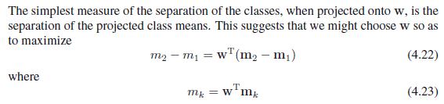
Discriminant Functions
Generative Models
Discriminative Models
(m₂ − m₁)²
w^{T} S_{B} w
J(w) =
s² + s² ⁼ w^{T} S w (using Projection y_{n} = w^{T} x_{n} in s_{k}²
1 2
W
Between-class covariance:
S_{B} = (m₂ − m₁)(m₂ − m₁)^{T}
Within-class covariance:
S_{W} =
Σ
T
Σ
T
(x − m )(x − m ) + (x −
m₂)(x_{n} − m₂)
n 1 n 1 n
n∈C1
:
n∈C2
w ∝ S⁻¹(m₂ − m₁)
W
If covariance S_{W} is isotropic, reduces to class mean difference vector

Slide 35
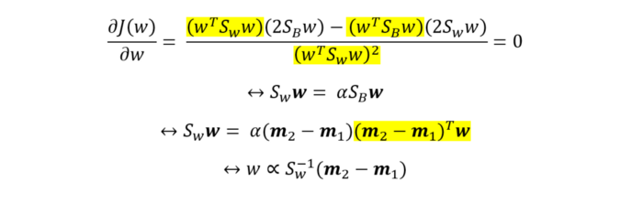
Discriminant Functions
Generative Models
Discriminative Models
(m₂ − m₁)²
w^{T} S_{B} w (4.26)
J(w) =
s² + s² ⁼ w^{T} S w
1 2
W
Between-class covariance:
S_{B} = (m₂ − m₁)(m₂ − m₁)^{T}
Within-class covariance:
Σ
Σ
S_{W} =
T
T
(x − m )(x − m ) + (x −
m₂)(x_{n} − m₂)
n 1 n 1 n
n∈C1
n∈C2
W
If covariance S_{W} is isotropic , proportional to the unit matrix, w reduces to class mean difference vector

Slide 36
Discriminant Functions
Generative Models
Discriminative Models
FLD Summary
FLD is a dimensionality reduction technique (more later in the course)
Criterion for choosing projection based on class labels
Still suffers from outliers (e.g. earlier least squares example)
Refer pg 191 for FDA for multiple classes

Slide 37
Discriminant Functions
Generative Models
Discriminative Models
Perceptrons
Perceptrons is used to refer to many neural network structures (more in Chapter 5.)
The classic type is a fixed non-linear transformation of input, one layer of adaptive weights, and a threshold:
y(x) = f (w^{T} φ(x))
Developed by Rosenblatt in the 50s
The main difference compared to the methods we’ve seen so far is the learning algorithm

Slide 38
Discriminant Functions
Generative Models
Discriminative Models
Perceptron Learning
Two class problem
For ease of notation, we will use t = 1 for class C₁ and t = −1
for class C₂
We saw that squared error was problematic
Instead, we’d like to minimize the number of misclassified examples
An example is mis-classified if w^{T} φ(x_{n})t_{n} < 0
Perceptron criterion:
Σ
T
E (w) = − w φ(x )t
P n n
n∈M
sum over mis-classified examples only

Slide 39
Discriminant Functions
Generative Models
Discriminative Models
Perceptron Learning
Two class problem
For ease of notation, we will use t = 1 for class C₁ and t = −1
for class C₂
We saw that squared error was problematic
Instead, we’d like to minimize the number of misclassified examples
An example is mis-classified if w^{T} φ(x_{n})t_{n} < 0
Perceptron criterion:
Σ
T
E (w) = − w φ(x )t
P n n
n∈M
sum over mis-classified examples only
Linear Models for Classification
Alireza Ghane / Greg Mori
39

Slide 40
Discriminant Functions
Generative Models
Discriminative Models
Perceptron Learning
Two class problem
For ease of notation, we will use t = 1 for class C₁ and t = −1
for class C₂
We saw that squared error was problematic
Instead, we’d like to minimize the number of misclassified examples
An example is mis-classified if w^{T} φ(x_{n})t_{n} < 0
Perceptron criterion:
Σ
T
E (w) = − w φ(x )t
P n n
n∈M
sum over mis-classified examples only
Linear Models for Classification
Alireza Ghane / Greg Mori
40

Slide 41
Discriminant Functions
Generative Models
Discriminative Models
Perceptron Learning
Two class problem
For ease of notation, we will use t = 1 for class C₁ and t = −1
for class C₂
We saw that squared error was problematic
Instead, we’d like to minimize the number of misclassified examples
An example is mis-classified if w^{T} φ(x_{n})t_{n} < 0
Perceptron criterion:
T
E (w) = − w φ(x )t
Σ
P n n
n∈M
sum over mis-classified examples only

Slide 42
Discriminant Functions
Generative Models
Discriminative Models
Perceptron Learning Algorithm
Minimize the error function using stochastic gradient descent (gradient descent per example):
w^{(τ +1)} = w^{(τ )} − η∇E_{P} (w)

Slide 43
Discriminant Functions
Generative Models
Discriminative Models
Perceptron Learning Algorithm
Minimize the error function using stochastic gradient descent (gradient descent per example):
w^{(τ +1)} = w^{(τ )} − η∇E_{P} (w) = w^{(τ )} + ηφ(x_{n})t_{n}
i`f in˛co¸rrec^{x}t
Iterate over all training examples, only change w if the example is mis-classified

Slide 44
Discriminant Functions
Generative Models
Discriminative Models
Perceptron Learning Algorithm
Minimize the error function using stochastic gradient descent (gradient descent per example):
w^{(τ +1)} = w^{(τ )} − η∇E_{P} (w) = w^{(τ )} + ηφ(x_{n})t_{n}
i`f in˛co¸rrec^{x}t
Iterate over all training examples, only change w if the example is mis-classified
Guaranteed to converge if data are linearly separable
Will not converge if not
May take many iterations
Sensitive to initialization

Slide 45
Discriminant Functions
Generative Models
Discriminative Models
Perceptron Learning Illustration
1
0.5
0
−0.5
−1
−1
−0.5
0
0.5
1

Slide 46
Discriminant Functions
Generative Models
Discriminative Models
Perceptron Learning Illustration
1
1
0.5
0.5
0
0
−0.5
−0.5
−1
−1
−1
−0.5
0
0.5
1 −1
−0.5
0
0.5
1

Slide 47

Discriminant Functions
Generative Models
Discriminative Models
Perceptron Learning Illustration
1
1
0.5
0.5
0
0
−0.5
−0.5
−1
−1
−1
−0.5
0
0.5
1 −1
−0.5
0
0.5
1
1
0.5
0
−0.5
−1
−1
−0.5
0
0.5
1

Slide 48
Discriminant Functions
Generative Models
Discriminative Models
Perceptron Learning Illustration
1
1
0.5
0.5
0
0
−0.5
−0.5
−1
−1
−1
−0.5
0
0.5
1
−1
−0.5
0
0.5
1
1
1
0.5
0.5
0
0
−0.5
−0.5
−1
−1
−1
−0.5
0
0.5
1
−1
−0.5
0
0.5
1

Slide 49
Discriminant Functions
Generative Models
Discriminative Models
Perceptron Learning Illustration
1
1
0.5
0.5
0
0
−0.5
−0.5
−1
−1
−1
−0.5
0
0.5
1
−1
−0.5
0
0.5
1
1
1
0.5
0.5
0
0
−0.5
−0.5
−1
−1
−1
−0.5
0
0.5
1
−1
−0.5
0
0.5
1
Convergence of the perceptron algorithm, showing data points from two classes (red and blue) in a 2-dim feature space (φ1, φ2). top left plot shows initial parameter vector w shown as a black arrow together with the corresponding decision boundary (black line), in which the arrow points towards the decision region which classified as belonging to the red class. The data point circled in green is misclassified and so its feature vector is added to the current weight vector, giving the new decision boundary shown in top right plot. bottom left plot shows next misclassified point to be considered, indicated by green circle, and its feature vector is again added to the weight vector giving the decision boundary shown in bottom right plot for which all data points are correctly classified.

Slide 50
Discriminant Functions
Generative Models
Discriminative Models
Limitations of Perceptrons
Perceptrons can only solve linearly separable problems in feature space
Same as the other models in this chapter
Canonical example of non-separable problem is X-OR
Real datasets can look like this too
I₁
1
?
0
0
1
I₂

Slide 51
Discriminant Functions
Generative Models
Discriminative Models
Outline
Discriminant Functions
Generative Models
Discriminative Models

Slide 52
Discriminant Functions
Generative Models
Discriminative Models
Probabilistic Generative Models
Up to now we’ve looked at learning classification by choosing parameters to minimize an error function
We’ll now develop a probabilistic approach
With 2 classes, C₁ and C₂:
p(x|C )p(C )
p(C |x) =
1 1
Bayes’ Rule
1
p(x)
p(x|C₁)p(C₁)
p(x, C₁) + p(x, C₂)
p(C |x) =
Sum rule
1
p(x|C )p(C )
p(C |x) =
1 1
Product rule
1
p(x|C₁)p(C₁) + p(x|C₂)p(C₂)
In generative models we specify the distribution p(x|C_{k}) which generates the data for each class

Slide 53
Discriminant Functions
Generative Models
Discriminative Models
Probabilistic Generative Models
Up to now we’ve looked at learning classification by choosing parameters to minimize an error function
We’ll now develop a probabilistic approach
With 2 classes, C₁ and C₂:
p(x|C )p(C )
p(C |x) =
1 1
Bayes’ Rule
1
p(x)
p(x|C₁)p(C₁)
p(x, C₁) + p(x, C₂)
p(C |x) =
Sum rule
1
p(x|C )p(C )
p(C |x) =
1 1
Product rule
1
p(x|C₁)p(C₁) + p(x|C₂)p(C₂)
In generative models we specify the distribution p(x|C_{k}) which generates the data for each class
Linear Models for Classification
Alireza Ghane / Greg Mori
53

Slide 54
Discriminant Functions
Generative Models
Discriminative Models
Probabilistic Generative Models
Up to now we’ve looked at learning classification by choosing parameters to minimize an error function
We’ll now develop a probabilistic approach
With 2 classes, C₁ and C₂:
p(x|C )p(C )
p(C |x) =
1 1
Bayes’ Rule
1
p(x)
p(x|C₁)p(C₁)
p(x, C₁) + p(x, C₂)
p(C |x) =
Sum rule
1
p(x|C )p(C )
p(C |x) =
1 1
Product rule
1
p(x|C₁)p(C₁) + p(x|C₂)p(C₂)
In generative models we specify the distribution p(x|C_{k}) which generates the data for each class
Linear Models for Classification
Alireza Ghane / Greg Mori
54

Slide 55
Discriminant Functions
Generative Models
Discriminative Models
Probabilistic Generative Models
Up to now we’ve looked at learning classification by choosing parameters to minimize an error function
We’ll now develop a probabilistic approach
With 2 classes, C₁ and C₂:
p(x|C )p(C )
p(C |x) =
1 1
Bayes’ Rule
1
p(x)
p(x|C₁)p(C₁)
p(x, C₁) + p(x, C₂)
p(C |x) =
Sum rule
1
p(x|C )p(C )
p(C |x) =
1 1
Product rule
1
p(x|C₁)p(C₁) + p(x|C₂)p(C₂)
In generative models we specify the distribution p(x|C_{k}) which generates the data for each class
Linear Models for Classification
Alireza Ghane / Greg Mori
55

Slide 56
Discriminant Functions
Generative Models
Discriminative Models
Probabilistic Generative Models
Up to now we’ve looked at learning classification by choosing parameters to minimize an error function
We’ll now develop a probabilistic approach
With 2 classes, C₁ and C₂:
p(x|C )p(C )
p(C |x) =
1 1
Bayes’ Rule
1
p(x)
p(x|C₁)p(C₁)
p(x, C₁) + p(x, C₂)
p(C |x) =
Sum rule
1
p(x|C )p(C )
p(C |x) =
1 1
Product rule
1
p(x|C₁)p(C₁) + p(x|C₂)p(C₂)
In generative models we specify the distribution p(x|C_{k}) which generates the data for each class
Linear Models for Classification
Alireza Ghane / Greg Mori
56

Slide 57
Discriminant Functions
Generative Models
Discriminative Models
Probabilistic Generative Models
Up to now we’ve looked at learning classification by choosing parameters to minimize an error function
We’ll now develop a probabilistic approach
With 2 classes, C₁ and C₂:
p(x|C )p(C )
p(C |x) =
1 1
Bayes’ Rule
1
p(x)
p(x|C₁)p(C₁)
p(x, C₁) + p(x, C₂)
p(C |x) =
Sum rule
1
p(x|C )p(C )
p(C |x) =
1 1
Product rule
1
p(x|C₁)p(C₁) + p(x|C₂)p(C₂)
In generative models we specify the distribution p(x|C_{k}) which generates the data for each class

Slide 58
Probabilistic Generative Models - Example
Discriminant Functions Generative Models Discriminative Models
Let’s say we observe x which is the current temperature
Determine if we are in Vancouver (C₁) or Honolulu (C₂)
Generative model:
p(x|C₁)p(C₁)
p(x|C₁)p(C₁) + p(x|C₂)p(C₂)
p(C |x) =
1
p(x|C₁) is distribution over typical temperatures in Vancouver
e.g. p(x|C1) = N (x; 10, 5)
p(x|C₂) is distribution over typical temperatures in Honolulu
e.g. p(x|C2) = N (x; 25, 5)
Class priors p(C₁) = 0.1, p(C₂) = 0.9
p(C |x = 15) =
0.0484·0.1 0.0484·0.1+0.0108·0.9
≈ 0.33
1

Slide 59
Probabilistic Generative Models - Example
Discriminant Functions Generative Models Discriminative Models
Let’s say we observe x which is the current temperature
Determine if we are in Vancouver (C₁) or Honolulu (C₂)
Generative model:
p(x|C₁)p(C₁)
p(x|C₁)p(C₁) + p(x|C₂)p(C₂)
p(C |x) =
1
p(x|C₁) is distribution over typical temperatures in Vancouver
e.g. p(x|C1) = N (x; 10, 5)
p(x|C₂) is distribution over typical temperatures in Honolulu
e.g. p(x|C2) = N (x; 25, 5)
Class priors p(C₁) = 0.1, p(C₂) = 0.9
p(C |x = 15) =
0.0484·0.1 0.0484·0.1+0.0108·0.9
≈ 0.33
1

Slide 60
Discriminant Functions
Generative Models
Discriminative Models
Generalized Linear Models
We can write the classifier in another form
p(x|C₁)p(C₁)
p(C₁|x) =
p(x|C₁)p(C₁) + p(x|C₂)p(C₂)
1
=
1 + exp(−a) ^{≡ σ(a)}
p(x|C₁)p(C₁)
a = ln
where
p(x|C₂)p(C₂)
This looks like gratuitous math, but if a takes a simple form this is another generalized linear model which we have been studying
Of course, we will see how such a simple form a = w^{T} x + w₀
arises naturally

Slide 61
Discriminant Functions
Generative Models
Discriminative Models
Generalized Linear Models
We can write the classifier in another form
p(x|C₁)p(C₁)
p(C₁|x) =
p(x|C₁)p(C₁) + p(x|C₂)p(C₂)
1
=
1 + exp(−a) ^{≡ σ(a)}
p(x|C₁)p(C₁)
a = ln
where
p(x|C₂)p(C₂)
This looks like gratuitous math, but if a takes a simple form this is another generalized linear model which we have been studying
Of course, we will see how such a simple form a = w^{T} x + w₀
arises naturally
Linear Models for Classification
Alireza Ghane / Greg Mori
61

Slide 62
Discriminant Functions
Generative Models
Discriminative Models
Generalized Linear Models
We can write the classifier in another form
p(x|C₁)p(C₁)
p(C₁|x) =
p(x|C₁)p(C₁) + p(x|C₂)p(C₂)
1
=
1 + exp(−a) ^{≡ σ(a)}
p(x|C₁)p(C₁)
a = ln
where
p(x|C₂)p(C₂)
This looks like gratuitous math, but if a takes a simple form this is another generalized linear model which we have been studying
Of course, we will see how such a simple form a = w^{T} x + w₀
arises naturally

Slide 63
Discriminant Functions
Generative Models
Discriminative Models
Logistic Sigmoid
1
0.5
0
−5
0
5
The function σ(a) =
1
is known as the logistic sigmoid
1+exp(−a)
It squashes the real axis down to [0, 1]
It is continuous and differentiable
It avoids the problems encountered with the too correct least-squares error fitting (later)

Slide 64
Discriminant Functions
Generative Models
Discriminative Models
Multi-class Extension
There is a generalization of the logistic sigmoid to K > 2
classes:
p(x|C_{k})p(C_{k})
p(C_{k}|x) =
Σ
p(x|C )p(C )
j
j j
exp(a_{k})
=
Σ
exp(a )
j
j
where
a_{k} = ln p(x|C_{k})p(C_{k})
a. k. a. softmax function
•
If some a_{k} a_{j} , p(C_{k}|x) goes to 1

Slide 65
Discriminant Functions
Generative Models
Discriminative Models
Multi-class Extension
There is a generalization of the logistic sigmoid to K > 2
classes:
p(x|C_{k})p(C_{k})
p(C_{k}|x) =
Σ
p(x|C )p(C )
j
j j
exp(a_{k})
=
Σ
exp(a )
j
j
where
a_{k} = ln p(x|C_{k})p(C_{k})
a. k. a. softmax function
If some a_{k >>} a_{j} , p(C_{k}|x) goes to 1, p(C_{j}|x) close to 0

Slide 66
Discriminant Functions
Generative Models
Discriminative Models
Gaussian Class-Conditional Densities
Back to that a in the logistic sigmoid for 2 classes
Let’s assume the class-conditional densities p(x|C_{k}) are Gaussians, and have the same covariance matrix Σ:
1 (2π)^{D/2}|Σ|^{1/2}
1
p(x|C ) =
T −1
k
exp − (x − µ ) Σ (x − µ )
2
k k
a takes a simple form:
a =
p(x|C₁)p(C₁)
ln = w^{T} x + w
p(x|C₂)p(C₂)
0
Note that quadratic terms x^{T} Σ⁻¹x cancel

Slide 67
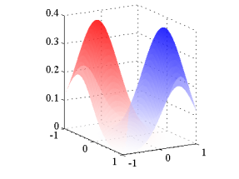
Discriminant Functions
Generative Models
Discriminative Models
Gaussian Class-Conditional Densities
Back to that a in the logistic sigmoid for 2 classes
Let’s assume the class-conditional densities p(x|C_{k}) are Gaussians, and have the same covariance matrix Σ:
1 (2π)^{D/2}|Σ|^{1/2}
1
p(x|C ) =
T −1
k
exp − (x − µ ) Σ (x − µ )
2
k k
a takes a simple form:
a =
p(x|C₁)p(C₁)
ln = w^{T} x + w
p(x|C₂)p(C₂)
0
T −1
Note that quadratic terms x Σ x cancel
Linear Models for Classification Alireza Ghane / Greg Mori
67

Slide 68
Discriminant Functions
Generative Models
Discriminative Models
Gaussian Class-Conditional Densities
Back to that a in the logistic sigmoid for 2 classes
Let’s assume the class-conditional densities p(x|C_{k}) are Gaussians, and have the same covariance matrix Σ:
1 (2π)^{D/2}|Σ|^{1/2}
1
p(x|C ) =
T −1
k
exp − (x − µ ) Σ (x − µ )
2
k k
a takes a simple form:
a =
p(x|C₁)p(C₁)
ln = w^{T} x + w
p(x|C₂)p(C₂)
0
T −1
Note that quadratic terms x Σ x cancel
Linear Models for Classification Alireza Ghane / Greg Mori
68

Slide 69
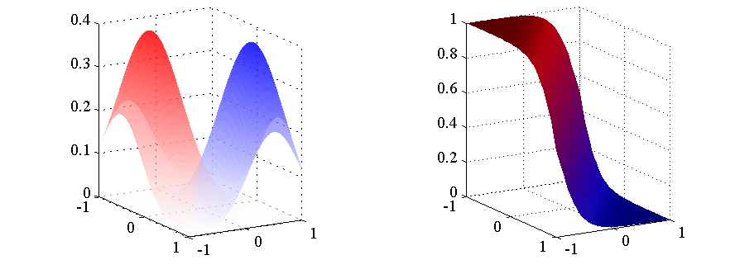
Discriminant Functions
Generative Models
Discriminative Models
Gaussian Class-Conditional Densities
Back to that a in the logistic sigmoid for 2 classes
Let’s assume the class-conditional densities p(x|C_{k}) are Gaussians, and have the same covariance matrix Σ:
1 (2π)^{D/2}|Σ|^{1/2}
1
p(x|C ) =
T −1
k
exp − (x − µ ) Σ (x − µ )
2
k k
a takes a simple form:
a =
p(x|C₁)p(C₁)
ln = w^{T} x + w
p(x|C₂)p(C₂)
0
Note that quadratic terms x^{T} Σ⁻¹x cancel

Slide 70
Discriminant Functions
Generative Models
Discriminative Models
Maximum Likelihood Learning
We can fit the parameters to this model using maximum likelihood
Parameters are µ₁, µ₂, Σ⁻¹, p(C₁) ≡ π, p(C₂) ≡ 1 − π
Refer to as θ
For a datapoint x_{n} from class C₁ (t_{n} = 1):
p(x_{n}, C₁) = p(C₁)p(x_{n}|C₁) = πN (x_{n}|µ₁, Σ)
•
For a datapoint x_{n} from class C₂ (t_{n} = 0):
p(x_{n}, C₂) = p(C₂)p(x_{n}|C₂) = (1 − π)N (x_{n}|µ₂, Σ)

Slide 71
Discriminant Functions
Generative Models
Discriminative Models
Maximum Likelihood Learning
We can fit the parameters to this model using maximum likelihood
Parameters are µ₁, µ₂, Σ⁻¹, p(C₁) ≡ π, p(C₂) ≡ 1 − π
Refer to as θ
For a datapoint x_{n} from class C₁ (t_{n} = 1):
p(x_{n}, C₁) = p(C₁)p(x_{n}|C₁) = πN (x_{n}|µ₁, Σ)
•
For a datapoint x_{n} from class C₂ (t_{n} = 0):
p(x_{n}, C₂) = p(C₂)p(x_{n}|C₂) = (1 − π)N (x_{n}|µ₂, Σ)

Slide 72
Discriminant Functions
Generative Models
Discriminative Models
Maximum Likelihood Learning
We can fit the parameters to this model using maximum likelihood
Parameters are µ₁, µ₂, Σ⁻¹, p(C₁) ≡ π, p(C₂) ≡ 1 − π
Refer to as θ
For a datapoint x_{n} from class C₁ (t_{n} = 1):
p(x_{n}, C₁) = p(C₁)p(x_{n}|C₁) = πN (x_{n}|µ₁, Σ)
For a datapoint x_{n} from class C₂ (t_{n} = 0):
p(x_{n}, C₂) = p(C₂)p(x_{n}|C₂) = (1 − π)N (x_{n}|µ₂, Σ)
Refer Max likelihood based parameter estimation pdfs uploaded for univariate and multivariate Gaussian distributions

Slide 73
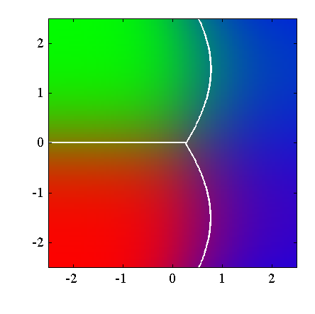
Discriminant Functions
Generative Models
Discriminative Models
Gaussian with Different Covariances
2.5
2
1.5
1
0.5
0
−0.5
−1
−1.5
−2
−2.5
−2
−1
0
1
2
p(x|C_{b})p(C_{b})
a = ln
p(x|C_{r})p(C_{r})
a = ln(p(x|C_{b})) − ln(p(x|C_{r})) + ln(p(C_{b})) − ln(p(C_{r}))
` x
−(x−`µ_{b})^{T} Σ_{b}(x−µ_{b}˛)+¸ (x−µ_{r} )^{T} Σ_{r} (x^{x}−µ_{r} )
co˛n¸st.

Slide 74
Discriminant Functions Generative Models
Discriminative Models
Probabilistic Generative Models Summary
Posterior given by generalized linear models with logistic sigmoid for K=2 , Softmax for K>=2 classes
Fitting Gaussian using ML criterion is sensitive to outliers

Slide 75
Discriminant Functions
Generative Models
Discriminative Models
Outline
Discriminant Functions
Generative Models
Discriminative Models

Slide 76
Discriminant Functions
Generative Models
Discriminative Models
Probabilistic Discriminative Models
Generative model made assumptions about form of class-conditional distributions (e.g. Gaussian)
Resulted in logistic sigmoid of linear function of x
Discriminative model - explicitly use functional form
1
p(C |x) =
1
T
1 + exp(−w x + w )
0
and find w directly
For the generative model we had 2M + M (M + 1)/2 + 1
parameters
M is dimensionality of x
Discriminative model will have M + 1 parameters

Slide 77
Discriminant Functions
Generative Models
Discriminative Models
Probabilistic Discriminative Models
Generative model made assumptions about form of class-conditional distributions (e.g. Gaussian)
Resulted in logistic sigmoid of linear function of x
Discriminative model - explicitly use functional form
1
p(C |x) =
1
T
1 + exp(−w x + w )
0
and find w directly
For the generative model we had 2M + M (M + 1)/2 + 1
parameters
M is dimensionality of x
Discriminative model will have M + 1 parameters
Linear Models for Classification
Alireza Ghane / Greg Mori
84

Slide 78
Discriminant Functions
Generative Models
Discriminative Models
Probabilistic Discriminative Models
Generative model made assumptions about form of class-conditional distributions (e.g. Gaussian)
Resulted in logistic sigmoid of linear function of x
Discriminative model - explicitly use functional form
1
p(C |x) =
1
T
1 + exp(−w x + w )
0
and find w directly
For the generative model we had 2M + M (M + 1)/2 + 1
parameters
M is dimensionality of x
Discriminative model will have M + 1 parameters

Slide 79
Discriminant Functions
Generative Models
Discriminative Models
Generative vs. Discriminative
Generative models
Discriminative models
Can generate synthetic example
Only usable for classification
data
Don’t solve a harder problem than
Perhaps accurate classification is
you need to
equivalent to accurate synthesis
e.g. vision and graphics
Tend to have fewer parameters
Require good model of decision
Tend to have more parameters
boundary
Require good model of class distributions

Slide 80
